Slide 1
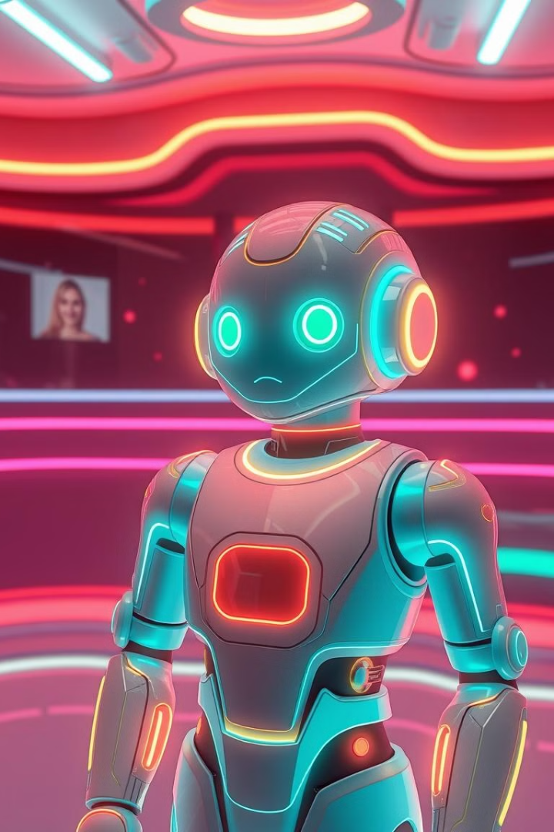
Chat Assistant for Database
Mini Project by Sai Naman

Slide 2
Problem Statement
Build an AI chatbot that will accept natural language queries from users, convert them into SQL statements, execute them on a provided SQLite database, and return clear, formatted responses. The chatbot should enable seamless interaction with the database without requiring users to have SQL knowledge, making data retrieval more accessible and efficient.

Slide 3
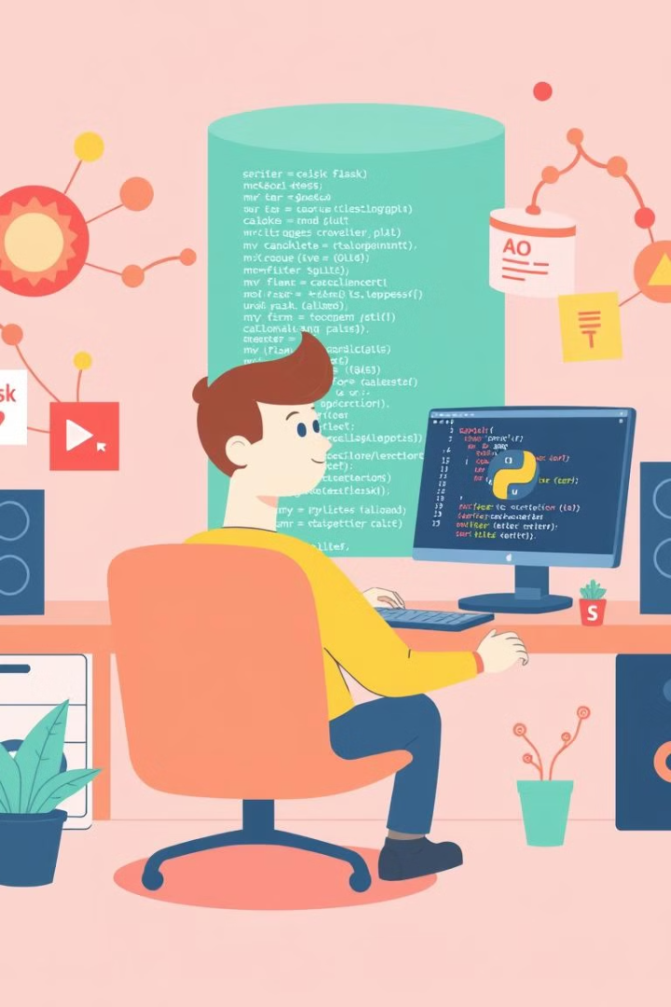
Tools and Libraries
1
Python as the primary programming language
2
Flask for web application framework
3
Flask-SQLAlchemy for database interactions with SQLite
4
Ollama for advanced language model integration

Slide 4
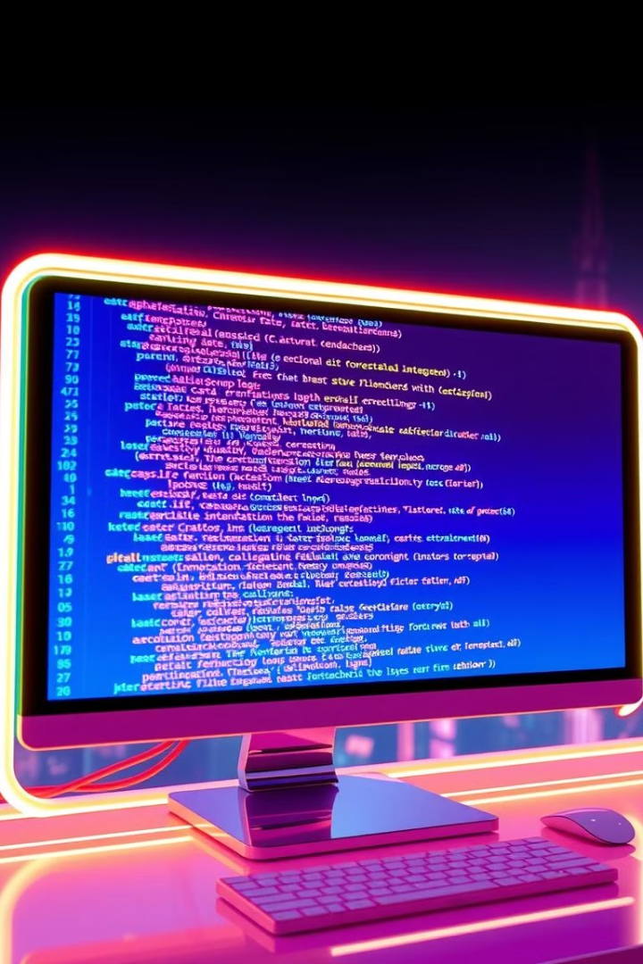
Model
Llama 3.2
The Meta Llama 3.2 collection of multilingual large language models is a collection of pre-trained and instruction-tuned generative models in 1B and 3B sizes. The Llama 3.2 instruction-tuned text only models are optimized for multilingual dialogue use cases, including agentic retrieval and summarization tasks.

Slide 5
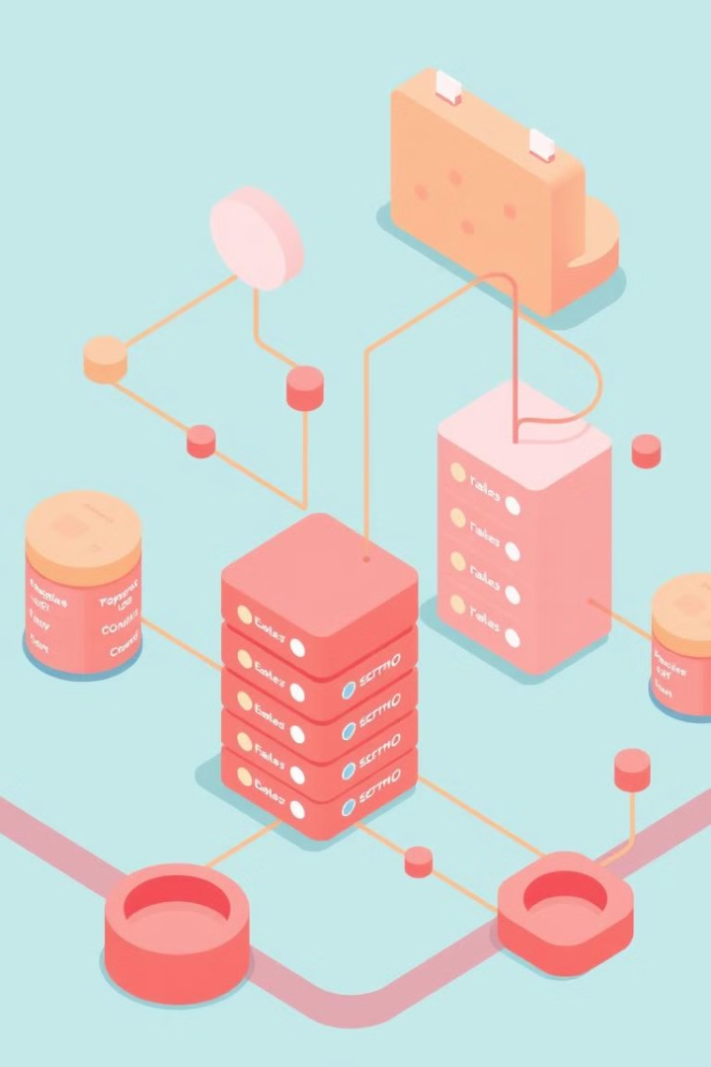
Database Schema
Employees Table
Departments Table
ID | Name | Department | Salary | Hire_Date
1 | Alice | Sales | 50000 | 2021-01-15
2 | Bob | Engineering | 70000 | 2020-06-10
3 | Charlie | Marketing | 60000 | 2022-03-20
ID | Name | Manager
1 | Sales | Alice
2 | Engineering | Bob
3 | Marketing | Charlie

Slide 6





Chatbot Functionality
Understanding user's natural language queries
Translating queries to SQL
Executing SQL queries against the database
Presenting results in a user-friendly format

Slide 7

User Interface and Interactions
http://127.0.0.1:5000
Sample Queries
Show me all employees in the [department] department.
Who is the manager of the [department] department?
List all employees hired after [date].
What is the total salary expense for the [department] department?

Slide 8
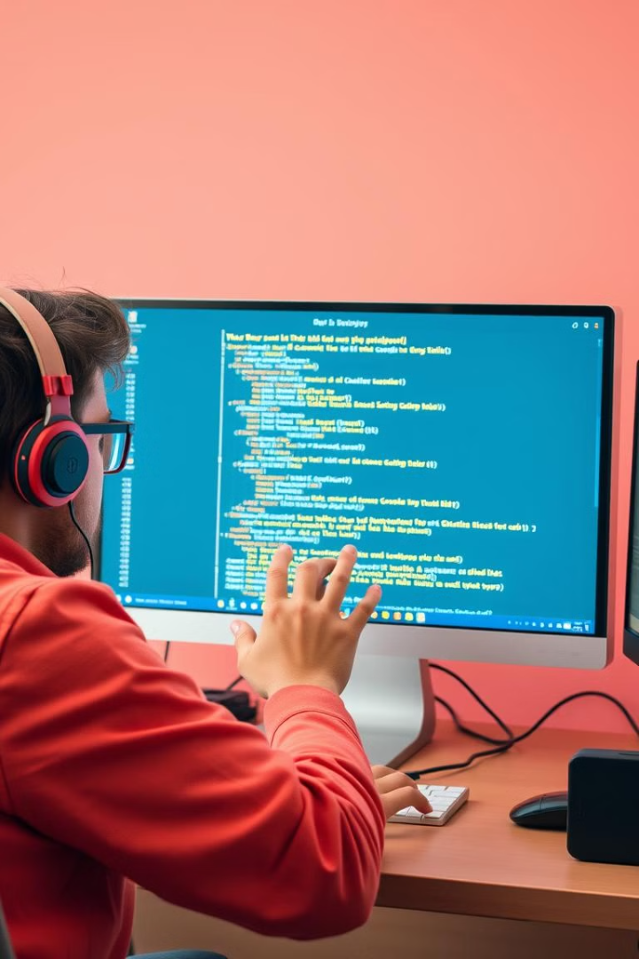
Challenges and Limitations
Handling complex and ambiguous queries
Ensuring accurate and efficient database interactions
Requires high computational resources for efficient processing

Slide 9

Thank You

